Slide 1
From Relational to Hadoop
Part 1: Introduction to Hadoop

Slide 2
Tutorial Logistics

Slide 3
Got VM?
Grab a USB
USB contains:
Cloudera QuickStart VM
Slides
Exercises and Solutions
Data

Slide 4
Plan of Action
I talk about Hadoop.
You multi-task between:
Listening to me talk about Hadoop
Installing Virtualbox and Running the VM

Slide 5
Using VirtualBox
Install and open VirtualBox on your computer
Under the menu "File", select "Import...”
Navigate to where you unpacked the .ovf file
and select it
You will find a “troubleshooting” file on the USB

Slide 6
Agenda – First 90 minutes
Why use Hadoop for ETL?
How HDFS Works?
How MapReduce Works?
What other tools we’ll use?

Slide 7

Use Hadoop for ETL?

Slide 8
ETL
Extracting data from outside sources
Transforming it to fit operational needs
Loading it into the end target
(Wikipedia: http://en.wikipedia.org/wiki/Extract,_transform,_load)

Slide 9
Why ETL?
Transform data before loading it to DB
XMLs, JSONs…
Clean and standardize data
Units, names…
Aggregate data, recommendations
De-normalize for a DWH

Slide 10
Some people do it like this:
Data Source
ETL Grid
Target System
Data Source

Slide 11
One Problem
8 hour processing pipeline can fail after 7.5 hours
Notes:
ETL grids don’t store much in-between states, so re-tries are challenging. Also a problem when the result is wrong and you need to go back and fix just one step.

Slide 12
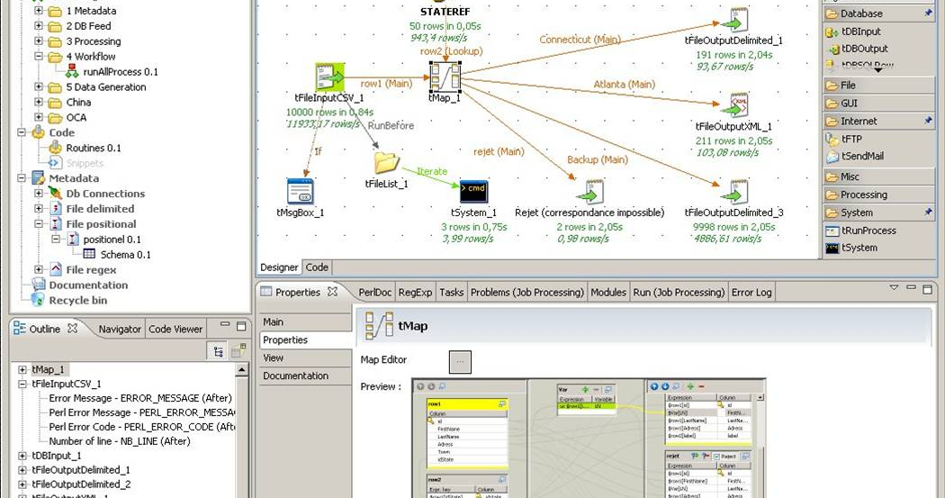
OK, two
Notes:
Point and click programming is not very flexible and difficult to optimize (if possible at all)

Slide 13
Or like this:
Data Source
Target System
Data Source

Slide 14
Few problems here too
Unstructured data is a bigger challenge
More contenders for CPU resources
Analysts
And even transactions
Storage can get expensive
Scaling DWH is a pain
SQL is a bit limited

Slide 15
Unpleasant Truth
MySQL is not a Data Warehouse
Notes:
Doesn’t have parallel processing engine, no star-schema optimizations, no bitmap indexes, no materialized views, limited SQL language support – no windowing functions
But you often need a data-warehouse. To combine data from multiple sources, BI, historical trends, data quality, retain low latency on OLTP system by offloading heavy queries and historical data.

Slide 16
You need a data warehouse
To combine data from multiple systems
Protect low-latency OLTP system
Optimize for reporting
Clean up data without rewriting OLTP system

Slide 17

Use Hadoop!
Handles unstructured data
Scales horizontally
Storage
CPU
Flexible and powerful
Lots of tools

Slide 18
In this tutorial we’ll show:
Basics of using Hadoop
Transform unstructured data
Get RDBMS data to Hadoop
Use Hadoop to join and aggregate
Load the results back to an RDBMS

Slide 19
HDFS: Distributed, fault-tolerant file system

Slide 20
Design Assumptions
Failures are common
More scale == more failure
Files are append-only
Files are large (Gigabytes +)
Access is large and sequential
Notes:
These are all DWH types of assumptions. Which makes Hadoop a pretty fantastic DWH

Slide 21
Quick Disk Primer
Disk does a seek for each I/O operation
Seeks are expensive (~10ms)
Throughput / IOPS tradeoff
100 MB/s and 10 IOPS
10MB/s and 100 IOPS
Big I/Os mean better throughput

Slide 22
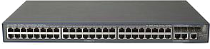

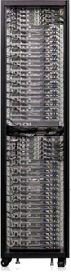
Quick Networking Primer
Core switch
Top-of-rack switch
Rack

Slide 23
Quick Networking Primer
23
40 Gbit Slow
10 Gbit Fast

Slide 24
HDFS Architecture
NameNode
Metadata
Paths, filenames, file sizes, block locations, …
Data blocks
DataNode
DataNode
DataNode
DataNode

Slide 25
Writing to HDFS
NameNode
create(“/tmp/myfile”)
Client
Write to [DN4,DN3,DN2]
[DN3,DN2]
[DN2]
DN 1
DN 2
DN 3
DN 4
Rack 1
Rack 2

Slide 26
Reading from HDFS
NameNode
open(“/tmp/myfile”,”r”)
Client
Read from [DN4,DN3,DN2]
Data
Read
DN 1
DN 2
DN 3
DN 4
Rack 1
Rack 2

Slide 27
Using HDFS
HDFS – command line interface
hdfs dfs –mkdir
hdfs dfs –ls
hdfs dfs –put
hdfs fsck

Slide 28
Practice Time
Create HDFS directory:
/etl/earthquakes/landing
Write earthquake data to directory
Get first 10 lines of file
How many blocks we have in the file?
What is the replication factor?

Slide 29
Solution
sudo –u hdfs hdfs dfs –mkdir /etl sudo –u hdfs dfs chown cloudera:cloudera /etl hdfs dfs –mkdir /etl/earthquakes/landing
hdfs dfs –put ~/datasets/earthquakes.json /etl/earthquakes/landing
hdfs dfs –cat /etl/earthquakes/landing/earthquakes.json | head -10
hdfs fsck /etl/earthquakes/landing/earthquakes.json

Slide 30
MapReduce: Programming and execution framework

Slide 31
Just implement two functions
Map:
Operate on every element
Filter, transform
Reduce:
Combine and aggregate results

Slide 32
Good news
Bad news
You don’t need to know MR
Many abstractions
Alternative frameworks
You still need to know MR
To understand how things work
Still widely in use

Slide 33
Map Reduce Architecture
NameNode
JobTracker
Gateway for users
Assigns tasks to TaskTrackers
Tracks job status
TaskTrackers execute Map and Reduce tasks assigned by JT
TT 1
TT 2
TT 3
TT 4
DN 1
DN 2
DN 3
DN 4

Slide 34
WordCount

Slide 35
Running MapReduce
NameNode
JobTracker
wordcount(<files>)
[cat, 1]
[the, 1]
[dog, 1]
[sat, 1]
M1
M2
M3
M4
R1
TT 1
TT 2
TT 3
TT 4
DN 1
DN 2
DN 3
DN 4

Slide 36
Running MapReduce
NameNode
JobTracker
wordcount(<files>)
[mat, 1]
[cat, 1]
[bad, 1]
[for, 1]
M1
M2
M3
M4
R1
TT 1
TT 2
TT 3
TT 4
DN 1
DN 2
DN 3
DN 4

Slide 37
MapReduce
NameNode
JobTracker
wordcount(<files>)
[a, 5]
[cat, 2]
[dog, 1]
[the, 4]
[mat, 1]
M1
M2
M3
M4
R1
TT 1
TT 2
TT 3
TT 4
DN 1
DN 2
DN 3
DN 4

Slide 38
Using MapReduce
Submit a JAR
Specify the class that contains the mapper and reducer
hadoop jar <jar> <class> <parameters>

Slide 39
Practice Time
Load “Works of Shakespeare” or other file to HDFS
Count words
Generate 100M of random data.
Run “terasort”.

Slide 40
Solution
sudo –u hdfs dfs –mkdir /user/training sudo –u hdfs dfs chown training:training /etl hdfs dfs –put shakespeare ~/
hadoop jar /usr/lib/hadoop-0.20-mapreduce/hadoop-examples.jar wordcount /user/cloudera/shakespeare /user/cloudera/cnt
hadoop jar /usr/lib/hadoop-0.20-mapreduce/hadoop-examples.jar teragen 1000000 /user/cloudera/terasort-in
hadoop jar /usr/lib/hadoop-0.20-mapreduce/hadoop-examples.jar terasort /user/cloudera/terasort-in /user/cloudera/terasort-out

Slide 41
Ecosystem Tools

Slide 42
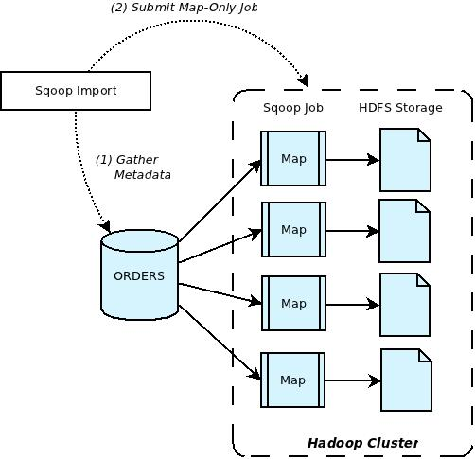
Sqoop
Transfers data between Hadoop and almost any SQL database with a JDBC driver

Slide 43





Flume
Streaming data collection
And aggregation for: JMS queues, HTTP APIs, Log4J, Syslog, etc.
Client
Agent
Client
Agent
Client
Agent
Client

Slide 44
Hive
Translate SQL to MapReduce
Select word,count(*) from shakespear
Group by word

Slide 45
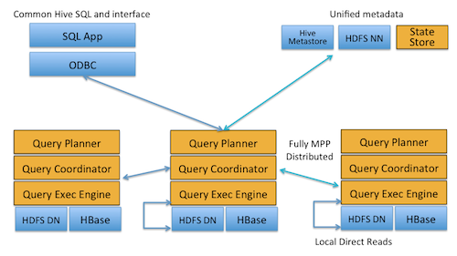
Impala
Modern MPP database built on top of HDFS
Really fast! Written in C++
10-100x faster than Hive

Slide 46
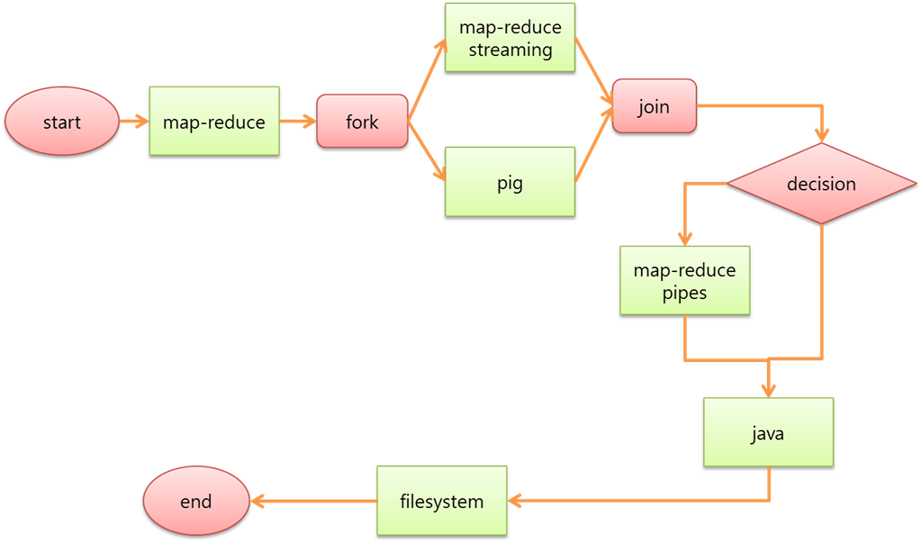
Oozie
A workflow engine and scheduler built specifically for large-scale job orchestration on a Hadoop cluster

Slide 47
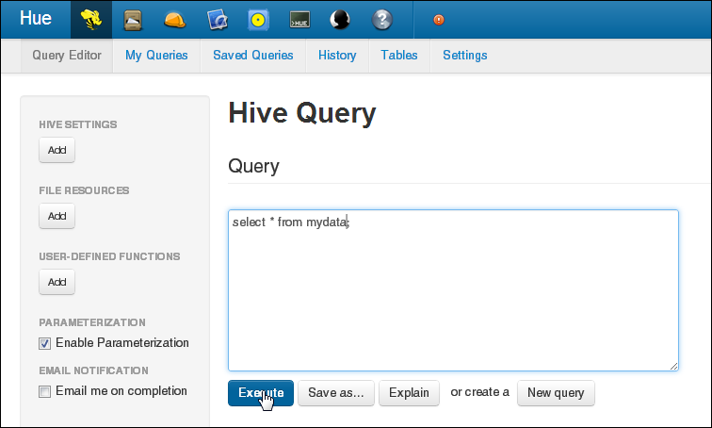
Hue
Hue is an open source web-based application for making it easier to use Apache Hadoop.
Hue features
File Browser for HDFS
Job Designer/Browser for MapReduce
Query editors
Oozie

Slide 48
Practice Time
Login to Hue
Play around
We will dive into Sqoop, Hive and Oozie in the next hour

Slide 49
Unpleasant Truth
MySQL is not a Data Warehouse
Notes:
Doesn’t have parallel processing engine, no star-schema optimizations, no bitmap indexes, no materialized views, limited SQL language support – no windowing functions
But you often need a data-warehouse. To combine data from multiple sources, BI, historical trends, data quality, retain low latency on OLTP system by offloading heavy queries and historical data.

Slide 50
You need a data warehouse
To combine data from multiple systems
Protect low-latency OLTP system
Optimize for reporting
Clean up data without rewriting OLTP system

